Slide 1
DATA ANALYTICS PROJECT IN CRICKET ANALYSIS
DOMAIN OF PROJECT | CRICKET ANALYSIS
PROPOSED PROJECT TITLE | CRICKET ANALYSIS IN MEN’S WORLD CUP 2023
NAME:SHNEHA.P
MENTOR: CHARULATHA

Slide 2
BUSINESS PROBLEM UNDERSTANDING
Analyze and visualize the performance of teams and individual players during the Cricket World Cup 2023 to identify key trends, patterns, and insights.
Develop interactive dashboards that allow users to explore the data in various ways, enabling them to gain a deeper understanding of the tournament and its outcomes.
EXPECTED OUTCOME
The analysis will focus on the Cricket World Cup 2023, including all matches played during the tournament.
Data sources will include official statistics from the International Cricket Council (ICC), as well as other relevant sources such as news articles, player profiles, and match commentary.

Slide 3
DATA SET INFORMATION
DATA SET SIZE TARGET VARIABLE DATA COLLECTION
148 KB WIN/LOSS KAGGLE .COM
DATA ATTRIBUTES
INDIA
AFGHANISTAN
PAKISTAN
AUSTALLIA
SRI LANKA
SOUTH AFRICA
NEW ZEALAND
ENGLAND
BANGLADESH
NETHERLANDS

Slide 4
TECHNOLOGY USED
MICROSOFT POWER BI
EXCEL
POWERPOINT

Slide 5
DATA ANALYSIS IN MEN’S CRICKET WORLD CUP 2023
Player Performance
Overall trends
Team strategies
DATA REQUIREMENTS
Match Data
Player Data
Team Data

Slide 6
EXPLORATORY DATA ANALYSIS
Detailed Information
Individual Statistics
Match History
Team Lineup
Match History

Slide 7
RESEARCH QUESTIONS
The project aims to answer the following research questions using the data:
Q1: Which team had the best performance in the ICC World Cup 2023?
Q2: Which player had the best performance in the ICC World Cup 2023?
Q3: Which venue had the most favorable conditions for batting and bowling in the ICC World Cup 2023?
Q4: How did the toss affect the outcome of the matches in the ICC World Cup 2023?
Q5: What were the key factors that influenced the results of the matches in the ICC World Cup 2023?

Slide 8
Overview: This section provides a summary of the ICC World Cup 2023, such as the number of matches, teams, players, venues, etc.
Team Performance: This section provides a comparison of the performance of different teams in the ICC World Cup 2023, such as the number of wins, losses, points, net run rate, etc
Player Performance: This section provides a comparison of the performance of different players in the ICC World Cup 2023, such as the number of runs, wickets, catches, etc.
Venue Analysis: This section provides an analysis of the characteristics of different venues in the ICC World Cup 2023, such as the average score, run rate, wicket rate, etc.
Toss Analysis: This section provides an analysis of the impact of the toss on the outcome of the matches in the ICC World Cup 2023, such as the win percentage, decision percentage, etc…
Match Factors: This section provides an analysis of the key factors that influenced the results of the matches in the ICC World Cup 2023, such as the batting order, partnership, powerplay, etc.

Slide 9
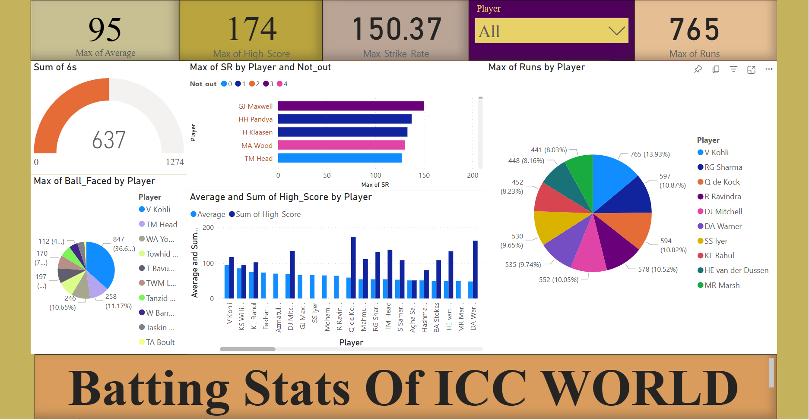

Slide 10
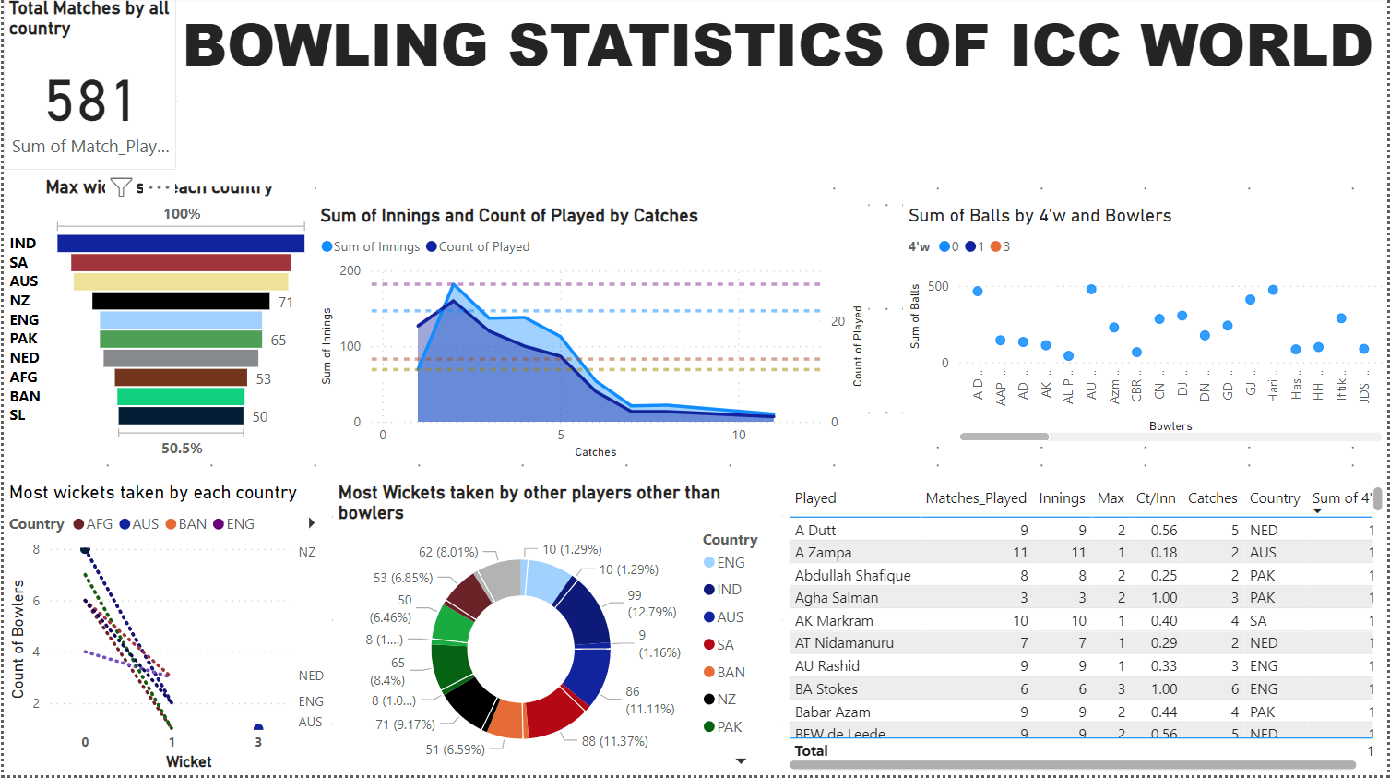

Slide 11
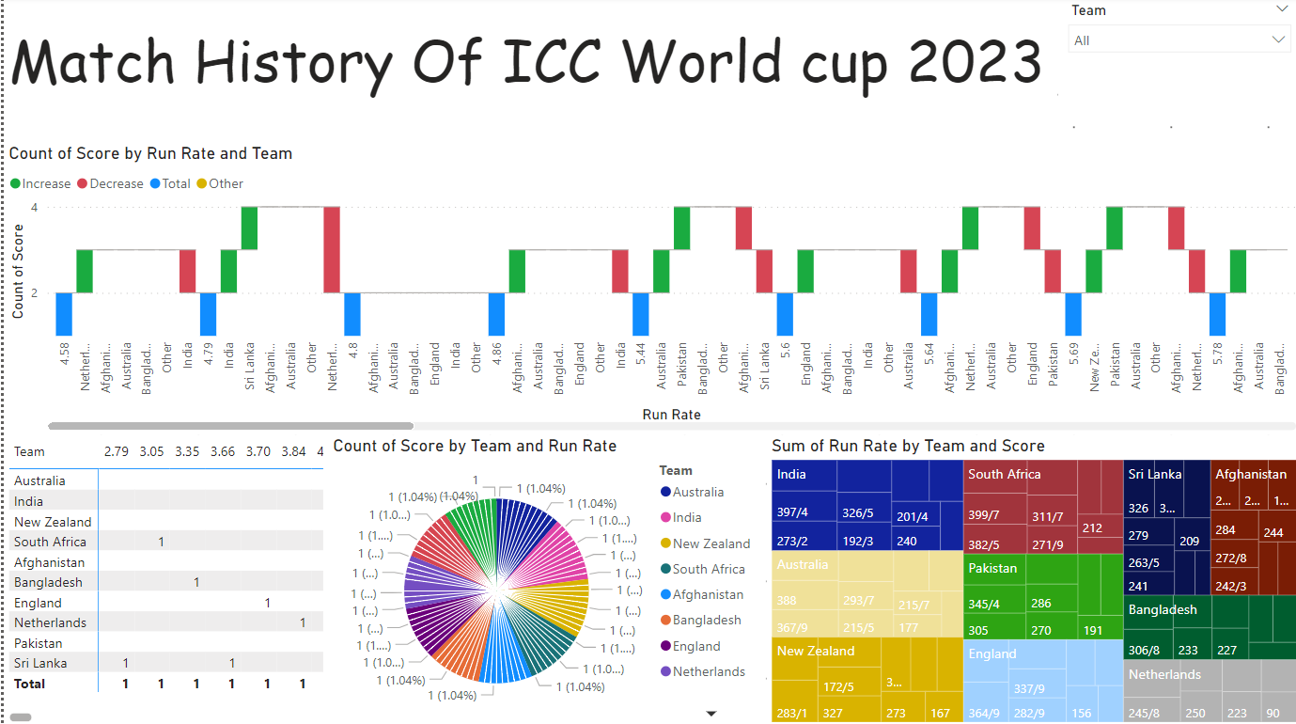

Slide 12
Conclusion
The project demonstrates data analysis of the ICC World Cup 2023. The project provides valuable insights into the performance of different teams, players, venues, etc. in the cricket tournament. The project also identifies the key factors that affected the results of the matches in the ICC World Cup 2023. The project can be further extended by adding more datasets, research questions, and analysis techniques.

